Slide 1
Computer Networks
By
Lt Col Ishtiaq Kiani
(10 Sep 12 to 12 Jan 13)

Slide 2
PART 2
Physical Layer

Slide 3
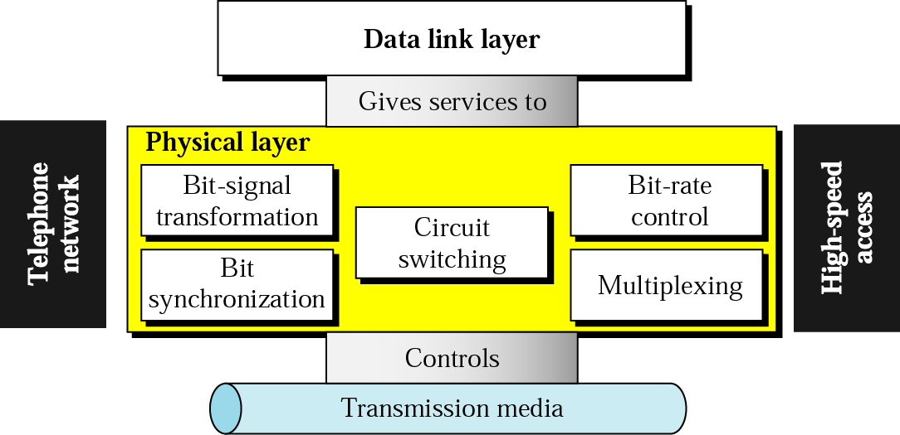
Position of the physical layer

Slide 4
Chapters
Chapter 3 Data and Signals
Chapter 4 Digital Transmission
Chapter 5 Analog Transmission
Chapter 6 Band width Utilization: Multiplexing
and Spreading
Chapter 7 Transmission Media
Chapter 8 Switching
Chapter 9 Using Telephone and Cable Network for
Data Transmission

Slide 5
Chapter 3 Data and Signal
Analog and Digital
Periodic Analog Signals
Digital Signals
Transmission Impairment
Data Rate limit
Performance

Slide 6
Data and Signal
To be transmitted, data must be transformed to electromagnetic signals.

Slide 7
Data and Signal
Transformation of Information to Signals

Slide 8
Analog and Digital
Analog Data
Digital Data
Analog examples:
telephone system, an electric current or the reproduction of patterned sound waves, audio/voice, video/image
Digitals examples:
bits ,

Slide 9
Analog and Digital
Analog Signal
Digital Signal
Signals can be analog or digital. Analog signals can have an infinite number of values in a range; digital signals can have only a limited number of values.

Slide 10
Analog and Digital
Comparison of Analog and Digital signals

Slide 11
Analog and Digital
Analog and Digital Clocks

Slide 12
Analog and Digital
Periodic Signals

Slide 13
Analog and Digital
Aperiodic Signals

Slide 14
Analog and Digital
In data communication, we commonly use periodic analog signals and aperiodic digital signals.

Slide 15
Periodic Analog Signals
Sine Wave

Slide 16
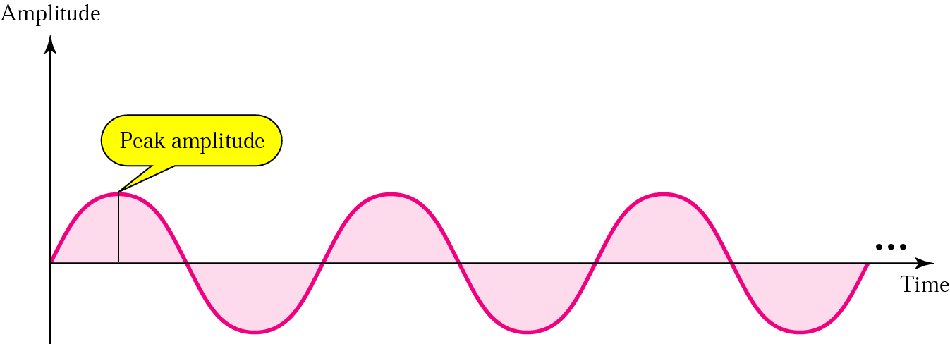
Periodic Analog Signals
Peak Amplitude

Slide 17
Periodic Analog Signals
Period and Frequency
Period refers to the amount of time, in seconds, a signal needs to complete 1 cycle.
Frequency refers to the number of periods in 1 second.
Frequency and period are inverses of each other.

Slide 18
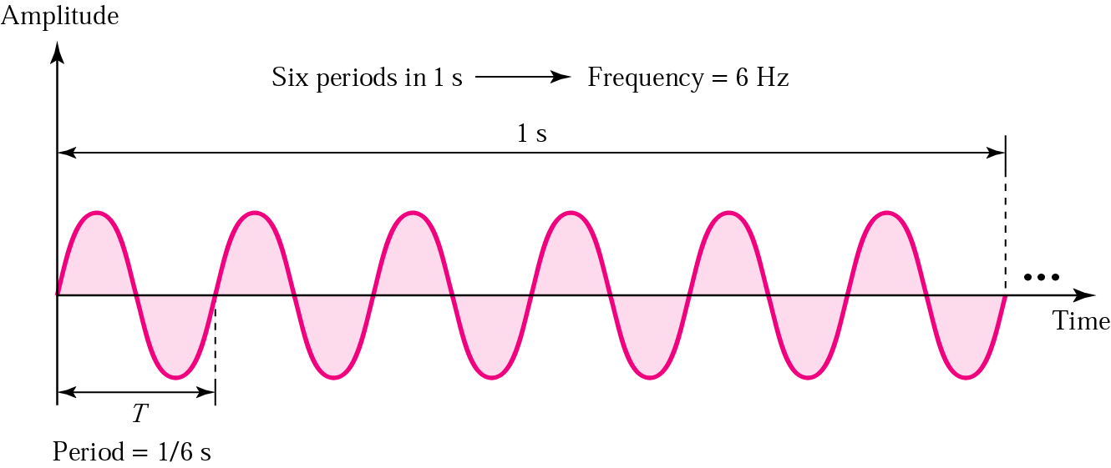
Periodic Analog Signals
Period and Frequency

Slide 19
Periodic Analog Signals
Units of periods and frequencies
Unit | Equivalent | Unit | Equivalent
Seconds (s) | 1 s | hertz (Hz) | 1 Hz
Milliseconds (ms) | 10^{–3} s | kilohertz (KHz) | 10³ Hz
Microseconds (ms) | 10^{–6} s | megahertz (MHz) | 10⁶ Hz
Nanoseconds (ns) | 10^{–9} s | gigahertz (GHz) | 10⁹ Hz
Picoseconds (ps) | 10^{–12} s | terahertz (THz) | 10¹² Hz

Slide 20
Periodic Analog Signals
Frequency
Frequency is the rate of change with respect to time. Change in a short span of time means high frequency. Change over a long span of time means low frequency.

Slide 21
Periodic Analog Signals
Frequency
If a signal does not change at all, its frequency is zero. If a signal changes instantaneously, its frequency is infinite.

Slide 22
Periodic Analog Signals
Phase
Phase describes the position of the waveform relative to time zero.

Slide 23
Periodic Analog Signals
Phase

Slide 24
Periodic Analog Signals
Frequency Change

Slide 25
Periodic Analog Signals
Amplitude Change

Slide 26
Periodic Analog Signals
Phase Change

Slide 27
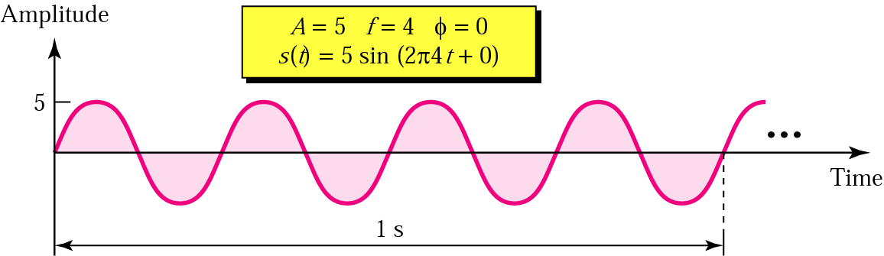
Periodic Analog Signals
Sine Wave Example

Slide 28
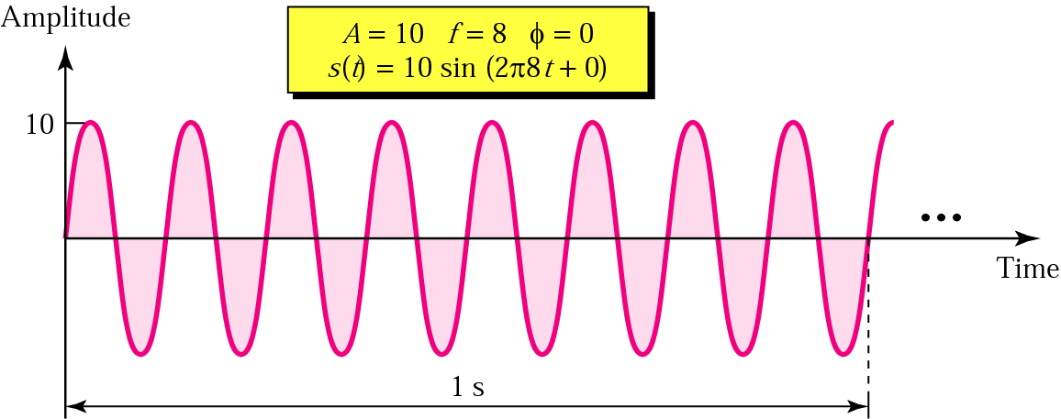
Periodic Analog Signals
Sine Wave Example

Slide 29
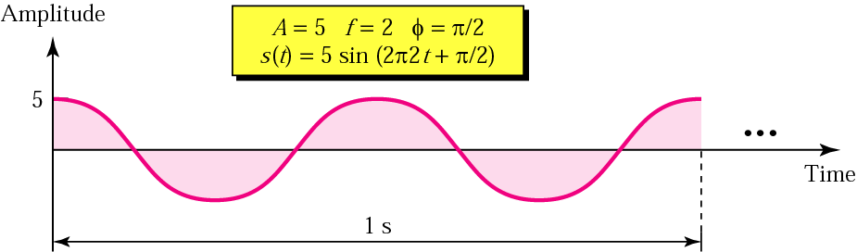
Periodic Analog Signals
Sine Wave Example

Slide 30
Periodic Analog Signals
Time and Frequency Domain
An analog signal is best represented in the frequency domain
A complete sine wave in a time domain can be represented by one single spike in the frequency domain

Slide 31
Periodic Analog Signals
Time and Frequency Domain Examples

Slide 32
Periodic Analog Signals
Composite Signals
A single-frequency sine wave is not useful in data communications; we need to change one or more of its characteristics to make it useful
When we change one or more characteristics of a single-frequency signal, it becomes a composite signal made of many frequencies
According to Fourier analysis, any composite signal can be represented as a combination of simple sine waves with different frequencies, phases, and amplitudes

Slide 33
Periodic Analog Signals
Composite Signals
If the composite signal is periodic, the decomposition gives a series of signals with discrete frequencies; if the composite signal is non-periodic, the decomposition gives a combination of sine waves with continuous frequencies

Slide 34
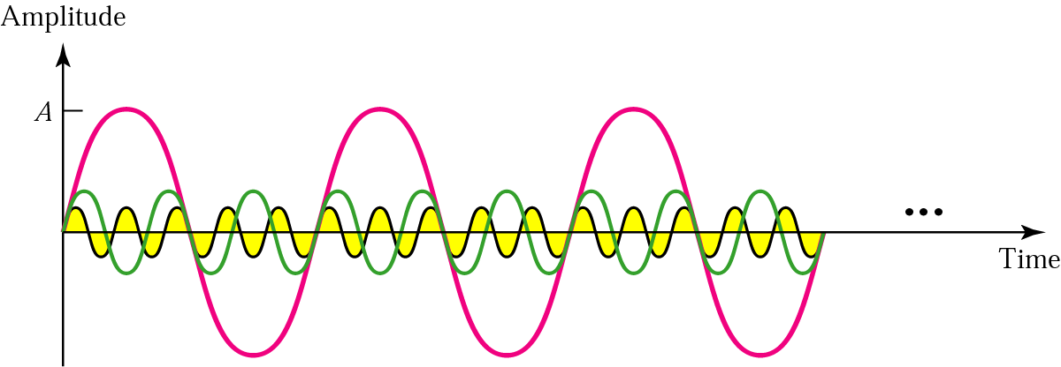
Periodic Analog Signals
Three harmonics

Slide 35
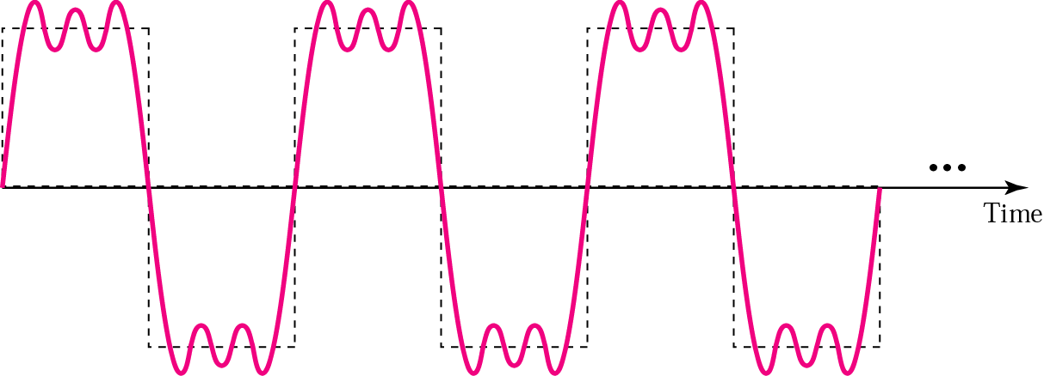
Periodic Analog Signals
Adding first three Harmonics

Slide 36
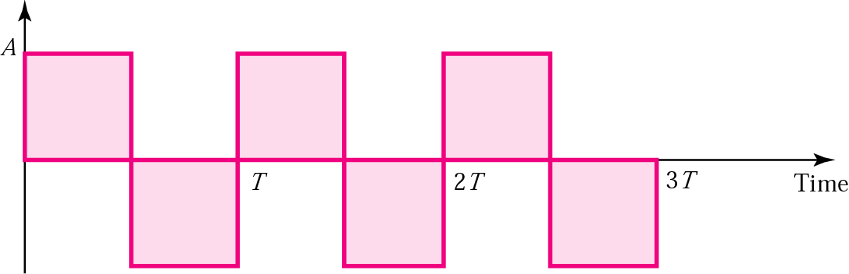
Periodic Analog Signals
Square wave

Slide 37
Periodic Analog Signals
Signal with DC Component

Slide 38
Periodic Analog Signals
Complex Waveform

Slide 39
Periodic Analog Signals
Bandwidth
The bandwidth is a property of a medium: It is the difference between the highest and the lowest frequencies that the medium can satisfactorily pass
we use the term bandwidth to refer to the property of a medium or the width of a single spectrum.

Slide 40
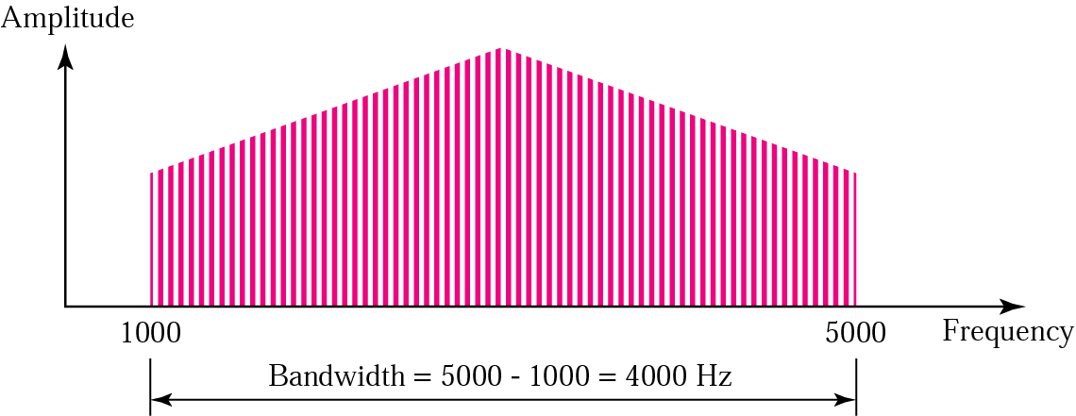
Periodic Analog Signals
Bandwidth

Slide 41
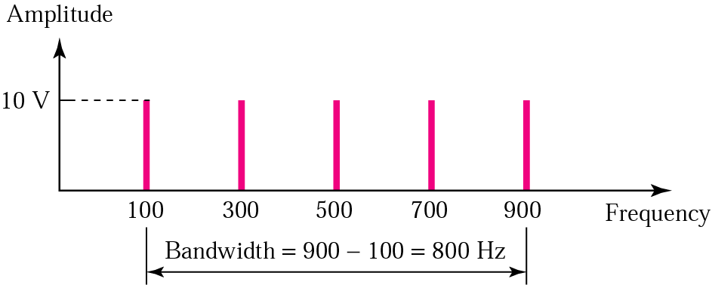
Periodic Analog Signals
Example
Bandwidth
If a periodic signal is decomposed into five sine waves with frequencies of 100, 300, 500, 700, and 900 Hz, what is the bandwidth? Draw the spectrum, assuming all components have a maximum amplitude of 10 V.
Solution
B = f_{h} − f_{l} = 900 − 100 = 800 Hz
The spectrum has five spikes, at 100, 300, 500, 700 & 900

Slide 42
Digital Signals

Slide 43
Digital Signals
Amplitude, Period & Phase for a Digital Signal

Slide 44
Digital Signals
Harmonics of a Digital Signal

Slide 45
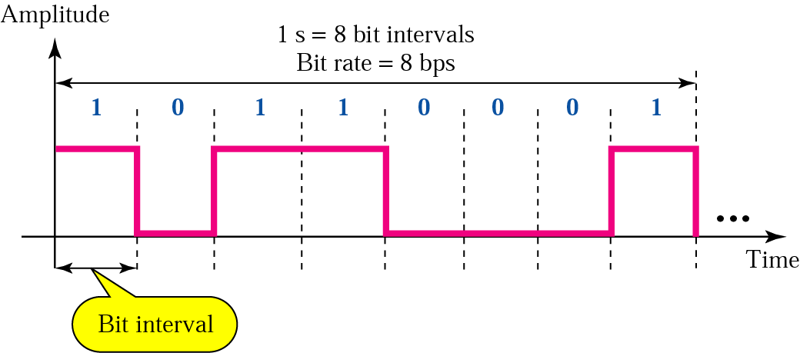
Digital Signals
Bit Rate and Bit Interval
Bit Interval is the time required to send one single bit
Bit Rate is no of bit intervals send per second

Slide 46
Digital Signals
Bit Length
The Bit Length is the distance one bit occupies on the transmission medium
Bit Length = Propagation Speed * Bit duration

Slide 47
Digital Signals
A digital signal is a composite signal with an infinite bandwidth
Bandwidth Requirements
Bit Rate | Harmonic 1 | Harmonics 1, 3 | Harmonics 1, 3, 5 | Harmonics 1, 3, 5, 7
1 Kbps | 500 Hz | 2 KHz | 4.5 KHz | 8 KHz
10 Kbps | 5 KHz | 20 KHz | 45 KHz | 80 KHz
100 Kbps | 50 KHz | 200 KHz | 450 KHz | 800 KHz
The bit rate and the bandwidth are proportional to each other.

Slide 48
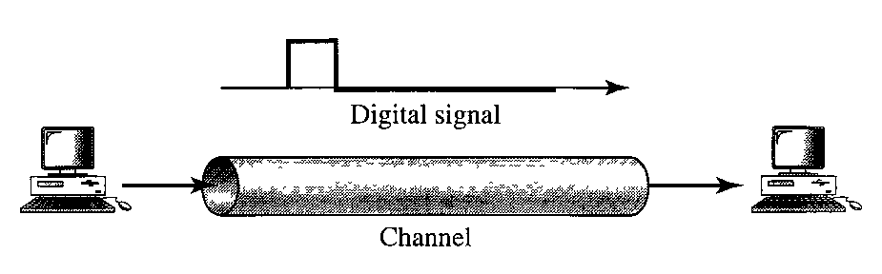
Digital Signals
Digital Signal as Composite Analog Signal
A digital signal is a composite analog signal with an infinite bandwidth
Baseband transmission means sending a digital signal over a channel without changing it to analog signal

Slide 49
Digital Signals
Transmission of Digital Signal
Baseband transmission of a digital signal that preserve the shape of digital signal is possible only if we have a low pass channel with an infinite or very wide BW
In baseband transmission, the required BW is proportional to the bit rate; if we need to send bits faster, we need more BW
Bit Rate | Harmonic 1 | Harmonics 1, 3 | Harmonics 1, 3, 5 | Harmonics 1, 3, 5, 7
1 Kbps | 500 Hz | 1.5 KHz | 2.5 KHz | 8 KHz
10 Kbps | 5 KHz | 15 KHz | 25 KHz | 80 KHz
100 Kbps | 50 KHz | 150 KHz | 250 KHz | 800 KHz

Slide 50
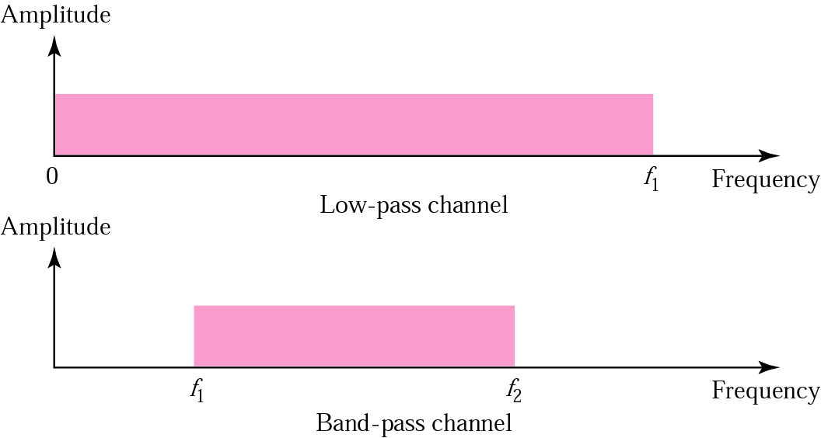
Digital Signals
Transmission of Digital Signal
Digital transmission needs a low-pass channel.
Analog transmission can use a band-pass channel.

Slide 51
Transmission Impairments
Signal travel through transmission media, which are not perfect. The imperfection causes signal impairment. This means what is sent is not what is received. Following are the causes of impairments:-
Attenuation
Distortion
Noise

Slide 52
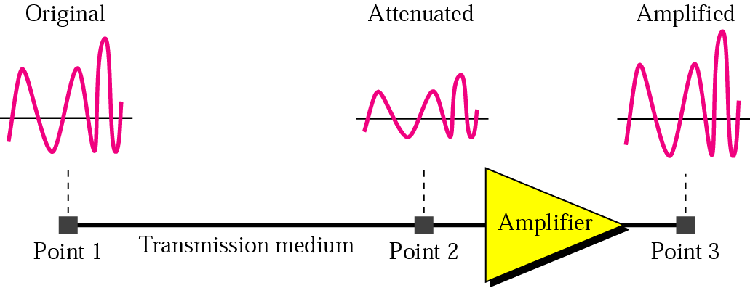
Transmission Impairments
Attenuation
Attenuation means loss of energy

Slide 53
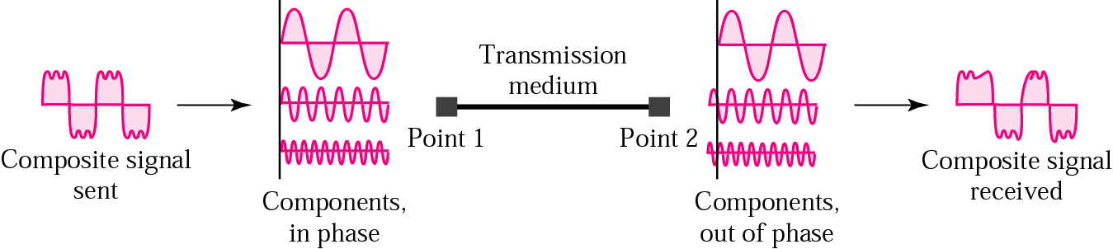
Transmission Impairments
Distortion
Distortion means that signal changes its form or shape

Slide 54
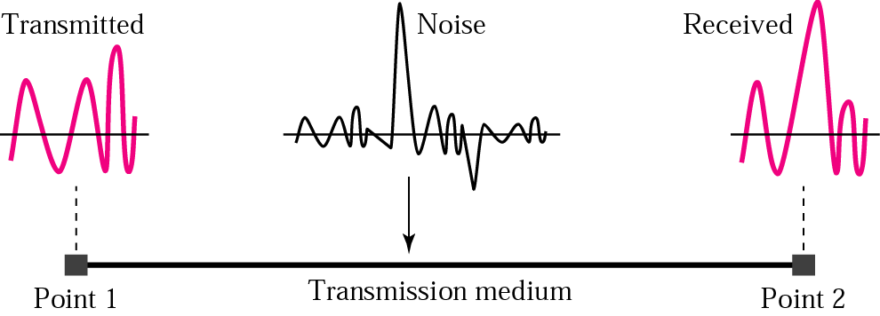
Transmission Impairments
Noise
Several types of noise such as thermal noise, induced noise, crosstalk and impulse noise may corrupt the signal

Slide 55
Transmission Impairments
Noise
Thermal noise is the random motion in a wire which causes an extra signal
Induced noise comes from sources such as motors and appliances, These devices act as a sending antenna and the transmission medium acts as receiving antenna
Crosstalk is the effect of one wire on the other. One wire act as sending antenna and other as receiving antenna
Impulse noise is a spike (a signal with high energy in a very short time) that comes from power lines, lightning and so on

Slide 56
Data Rate Limits
A very important consideration in data communications is how fast we can send data, in bits per second, over a channel. Data Rate depends on:-
The bandwidth available
The level of the signals we use
The quality of the channel
Two theoretical formulas were developed to calculate the data rate
Nyquist for a noiseless channel
Shannon for noisy channel

Slide 57
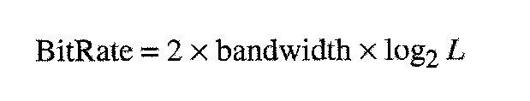
Data Rate Limits
Noiseless Channel – Nyquist Bit Rate
For a noiseless channel, the Nyquist bit rate formula defines theoretical maximum bit rate
Bandwidth is the bandwidth of channel
L is the no of signal level used

Slide 58


Data Rate Limits
Noisy Channel – Shannon Capacity
For a noisy channel, In 1944, Claude Shannon introduced a formula, called the Shannon capacity, to determine the theoretical highest data rate for a noisy channel:
SNR is the Signal to Noise Ratio
Bandwidth is the bandwidth of channel
Capacity is the capacity of the channel in bits per second

Slide 59
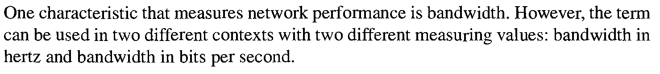
Performance
Bandwidth
The analog bandwidth of a medium is expressed in hertz;
The digital bandwidth, in bits per second.

Slide 60
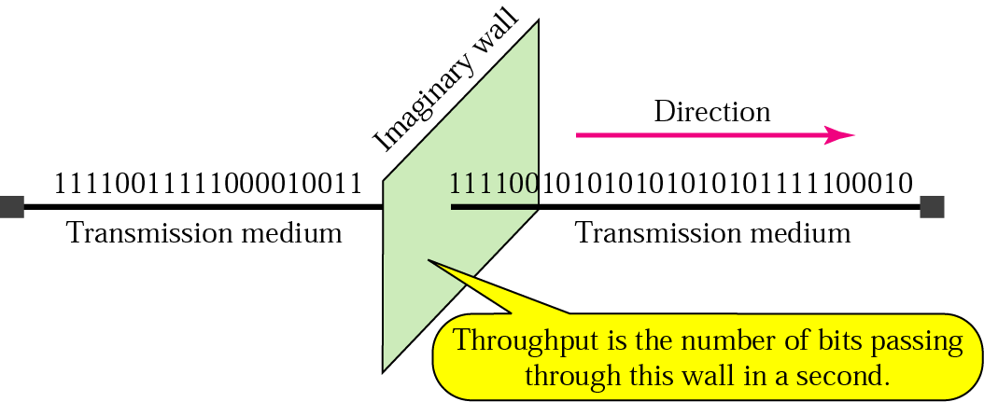
Performance
Throughput

Slide 61
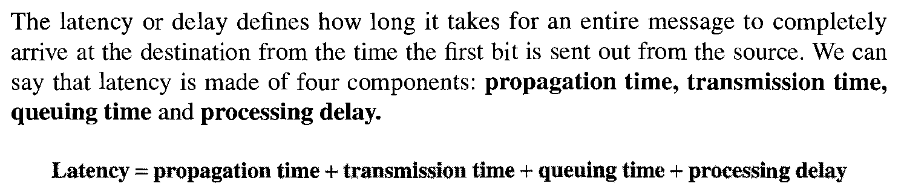
Performance
Latency (Delay)

Slide 62
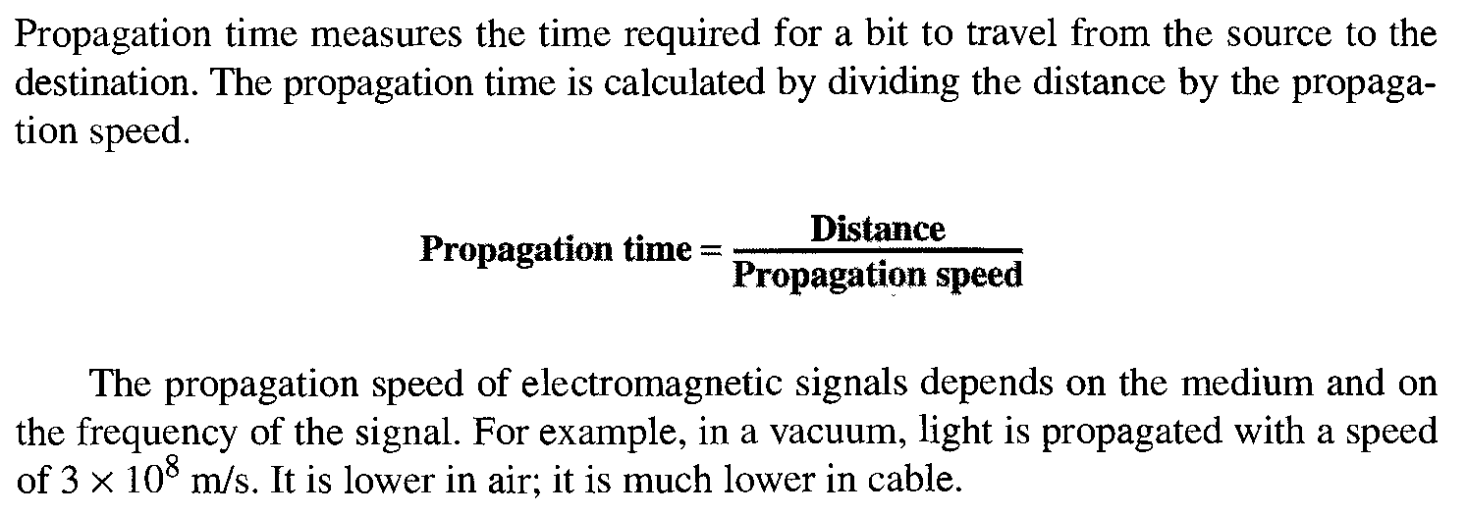
Performance
Propagation Time

Slide 63
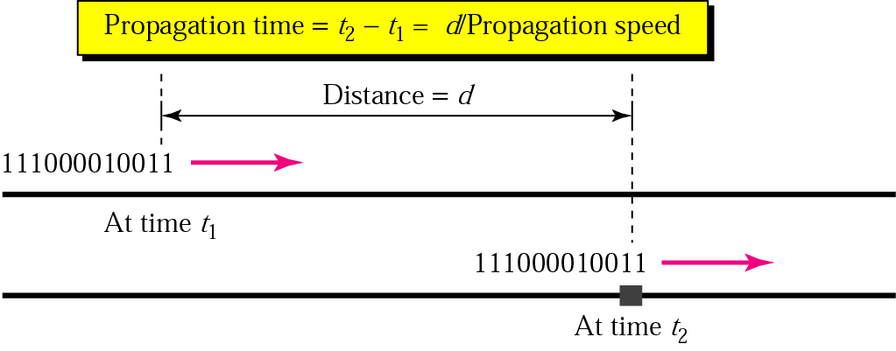
Performance
Propagation Time

Slide 64
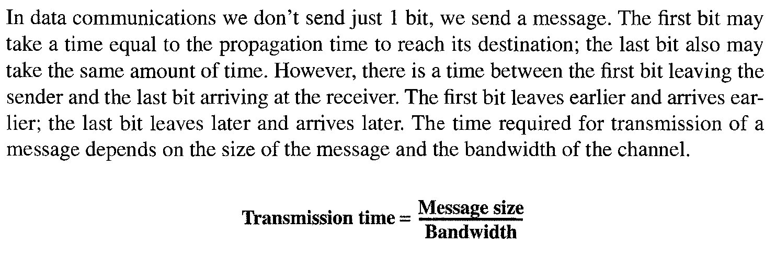
Performance
Time

Slide 65
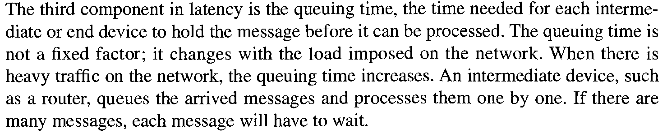
Performance
Queuing Time

Slide 66
Performance
Jitter

